Slide 1
Digital Streaming Service

Slide 2
Background
Digital System for the administrators to manage movies
Stores
Login Credentials
Movies
Actors
Reviews

Slide 3
Tech Stacks
Java 8
Spring Boot
JUNIT
Mockito
Postgresql

Slide 4
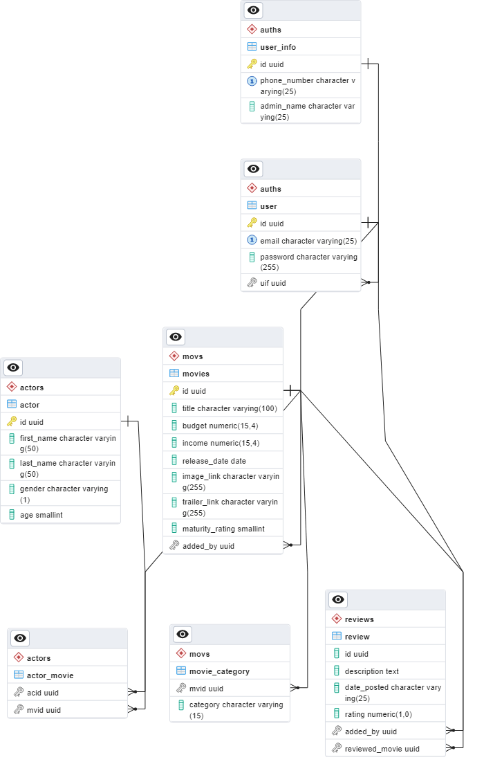
Database

Slide 5
Structure
Clients
Login Service 1
GateWay
FeignClient
(Proxy)
Login Service 2
Review Service
Movie Service
Actor Service

Slide 6
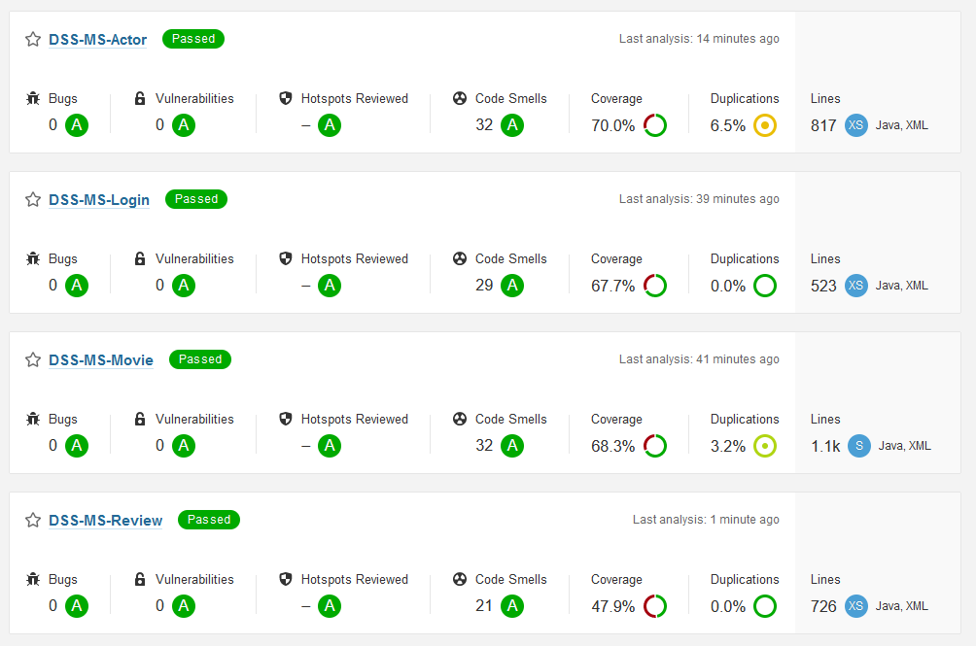
SonarQube and Jacoco

Slide 7
DEMO

